Slide 1
Providing the E in G x E x M (well, most of the E)
daryl herzmann
@akrherz
Agronomy 600B
5 Feb 2020

Slide 2
Genetics (G) x Environment (E) x Management (M)
Dr Jerry Hatfield’s et al review paper (Agronomy Journal 2015) introduces M into the G x E equation to increase actual yield vs just yield potential.
Knowledge of the Environment and Genetics can inform Management decisions.
Environmental variables relevant to G x E x M, our topics for today
Air Temperature, Humidity, and Wind
Precipitation
Solar Radiation
Soil Moisture and Temperature

Slide 3

Providing (most of) the E Iowa Environmental Mesonet
https://mesonet.agron.iastate.edu (Google: “IEM ISU”)
ISU Agronomy project since 2001
“Mesonet” is a meteorology term describing a network of observations on a spatial scale ~10s km
Crazy website with all kinds of apps and portals to get lost in and cry over.
Please please please, the main point for today, if you have trouble:
Tweet me! @akrherz
Call me! 515 294 5978
Stop by my office! 3027 Agronomy
Email me! akrherz@iastate.edu

Slide 4
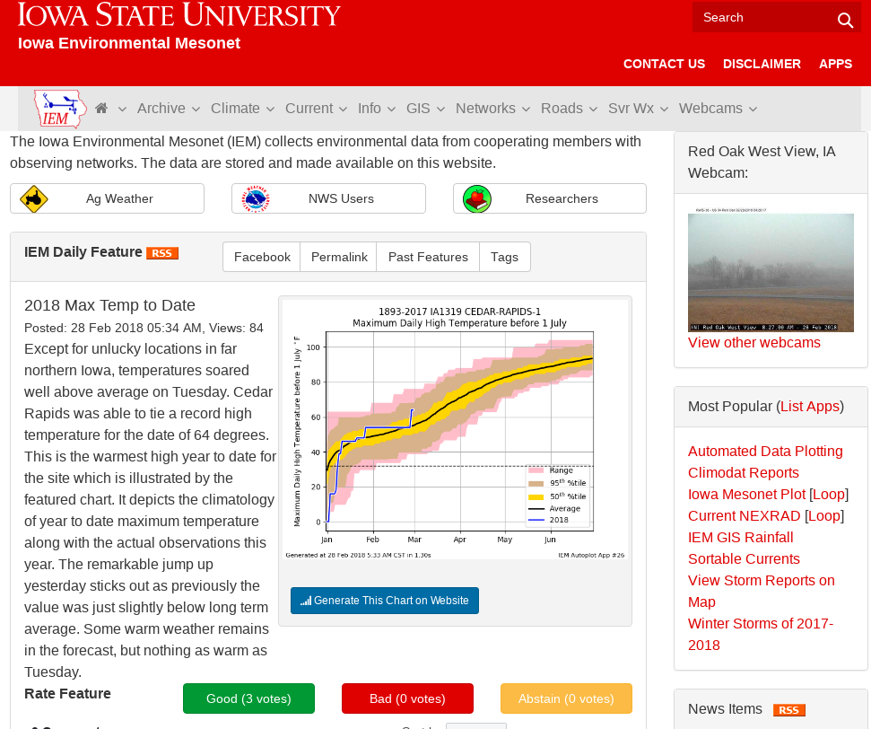
The website aggregates data from many different data sources.
Data is generally organized by acronym heavy “Networks”,
ISU Soil Moisture Network is one such network.
“Daily Feature” highlights some relevant and deep linked plot each day.

Slide 5
IEM Aggregated Networks
Acronym / Title | Description
ASOS / AWOS | General classification of Airport weather stations operated by the FAA, NWS, DoD, and state DOTs.
CoCoRaHS | Citizen science reporting “daily” snowfall, snow depth and precipitation.
NWS COOP | National Weather Service Cooperative Observers reporting “daily” high and low temperatures, precipitation, and snowfall.
DCP | General grouping of many different types of sensors that focus on hydrology.
ISU Soil Moisture | Iowa State operated network of weather stations focused on Agriculture weather data needs.
NLAE Flux | Advanced monitoring stations by the USDA NLAE monitoring various fluxes from agricultural landscapes.
RWIS | DOT Roadway Weather Information Systems monitoring weather and pavement state.
SCAN | USDA Soil Climate Analysis Network
Other | Various other stations.

Slide 6
Which network should I use?
Data Need | Time Interval | Recommendation
“Daily” High/Low Temps + Precipitation | Daily | NWS COOP IEM “Long Term Climate” / “Climodat”
Air Temperatures + Precipitation (not snow) | Hourly | ASOS/AWOS + ISU Soil Moisture
Wind | Daily + Hourly | ISU Soil Moisture ASOS / AWOS (Airport weather stations)
Solar Radiation | Daily + Hourly | ISU Soil Moisture
Soil Temperature/Moisture | Daily + Hourly | ISU Soil Moisture / SCAN
Humidity | Daily + Hourly | ISU Soil Moisture / ASOS / AWOS

Slide 7
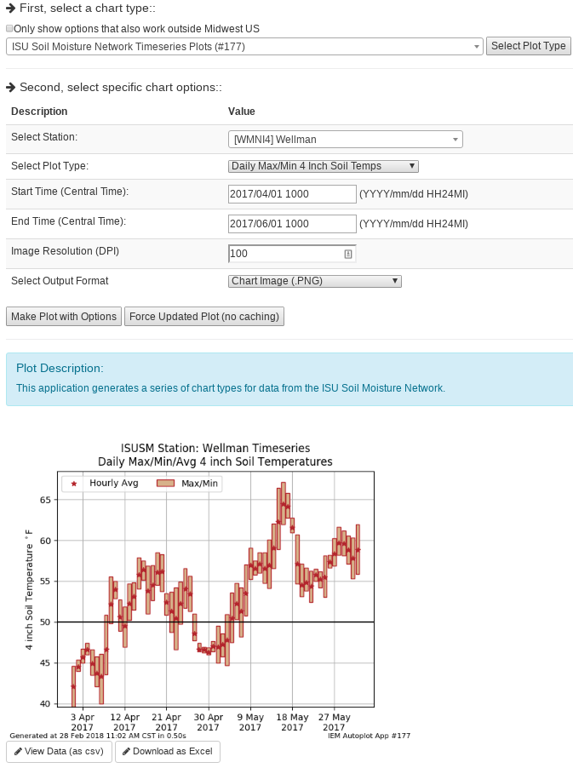
IEM Auto Plotting
Select Plot Type
Select Plot Options
Description
Custom Generated Plot
Download Raw Data (Excel)

Slide 8
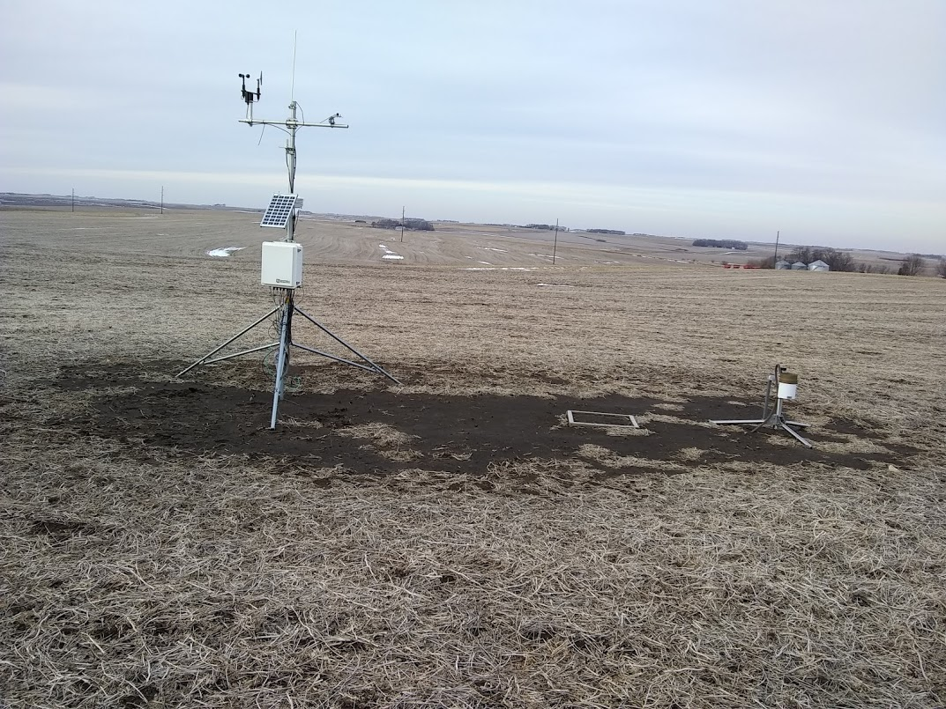
ISU Soil Moisture Station
Wind Speed
+ Direction
Solar Radiation
Solar Panel
Air Temp + Humidity
Tipping Bucket
Rain Gauge
Logger Enclosure
Bare soil for 4 inch
Depth Soil Temperature
12, 24, & 50 inch depth
Soil Temperature + Moisture

Slide 9
Data Variables to Discuss
Air Temperature, Humidity, and Wind
Precipitation
Soil Moisture/Temperature
Solar Radiation

Slide 10
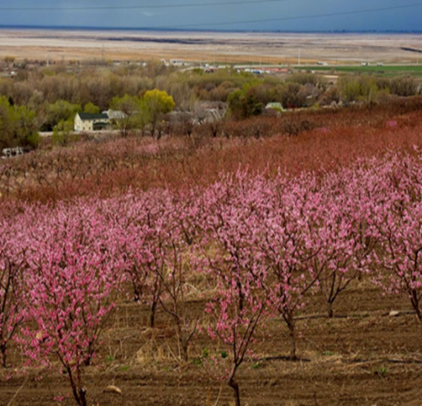
Understanding micro-climates
Subtle topography / elevation change makes a difference!
We don’t have enough sensors nor sensor sensitivity to measure this effect.
If you are studying agronomic variability at this scale, you likely need to consider that weather/climate varies too.
Photo: Dr Elywnn Taylor

Slide 11
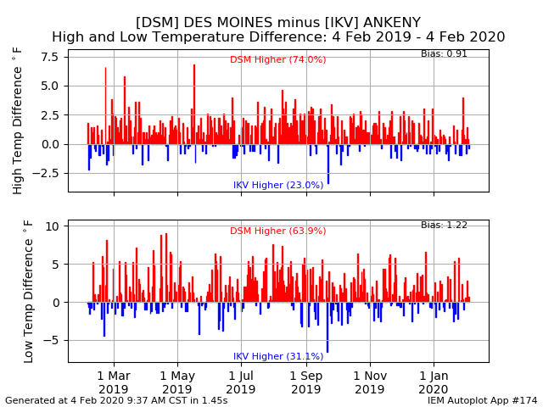
Urban Heat Island
Urban areas are generally warmer than rural due to albedo and heat holding capacity differences.
UHI is even noticeable in smaller Iowa towns.
Magnitude of this difference may not matter for your usage case.
Web Link

Slide 12
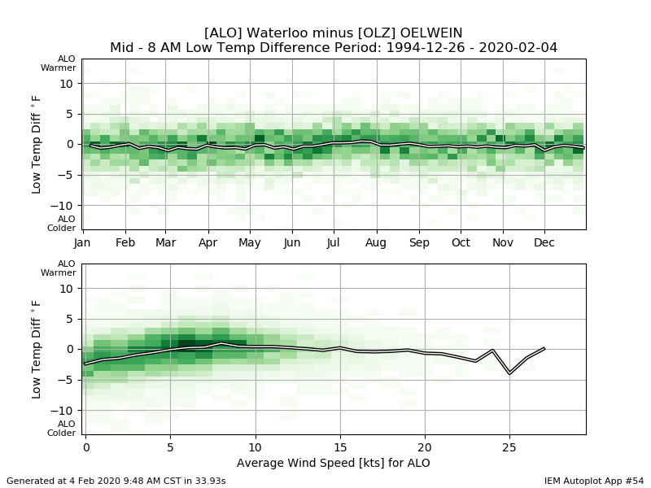
Soil Differences
Waterloo’s site has soil with larger sand content and will cool faster under light wind condition.
Web Link

Slide 13
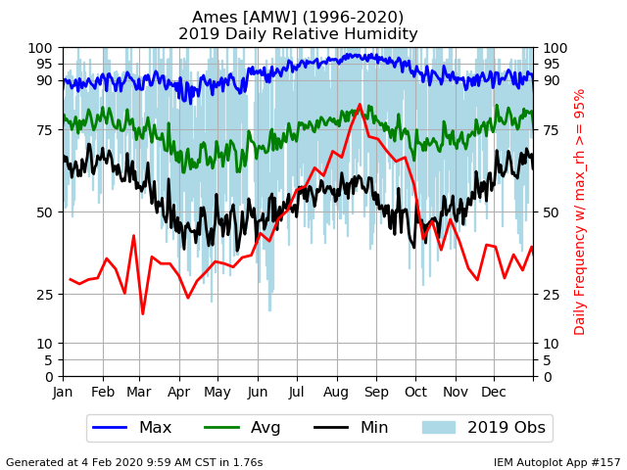
Relative Humidity
As the name implies, the value is relative.
On average, the lowest RH values happen in the spring/fall (black line).
Daily average RH is about the same in summer and winter (huh?)
Web Link

Slide 14
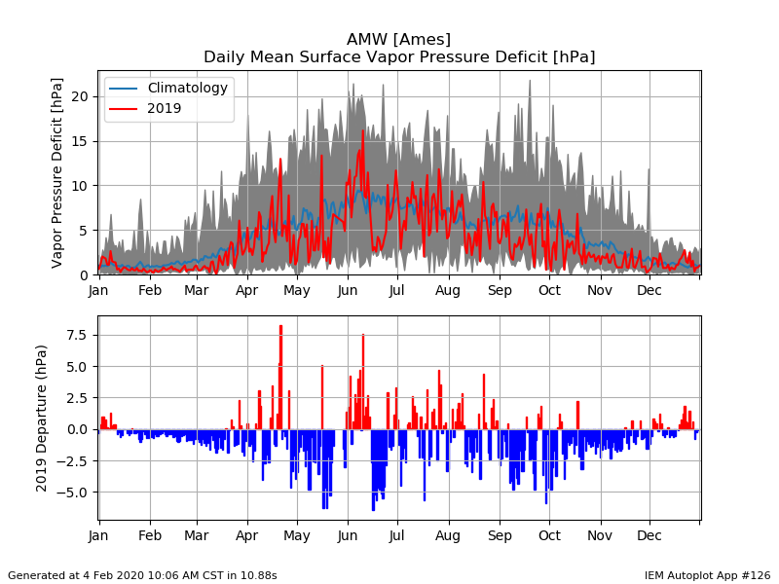
Vapor Pressure Deficit (VPD)
VPD is a more direct and comparable measure of humidity.
Air’s demand / pull of water vapor.
2019 values show a decreased demand from average.
Web Link

Slide 15
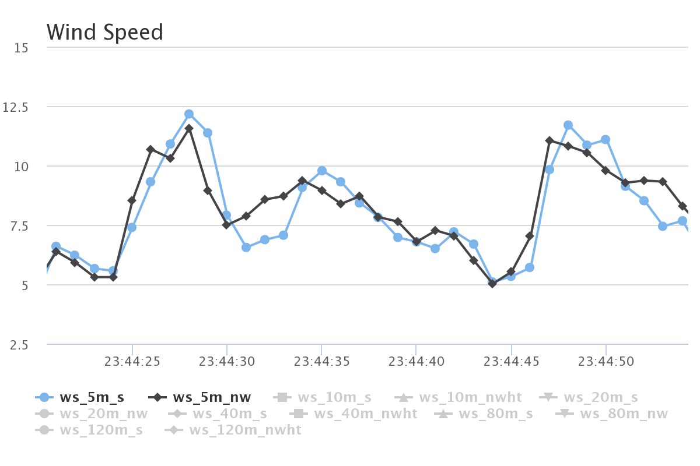
ISU “Tall Towers” 1 second interval Wind Speed [mps]
This entire plot is just 1 minute of data!
Two sensors at same height, mounted at different directions on the tower. We also have 20 Hz data ☺

Slide 16
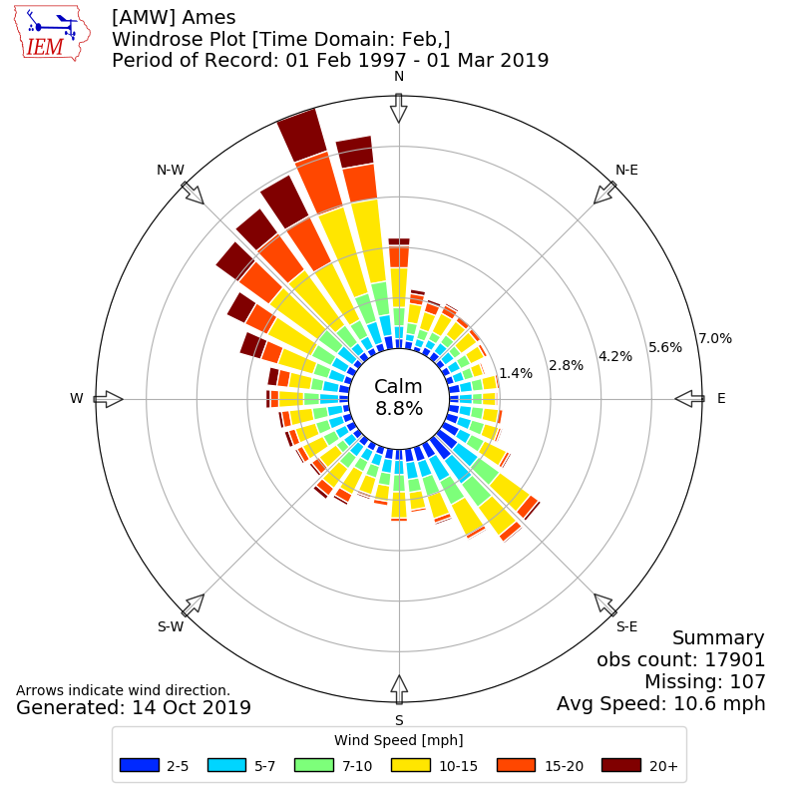
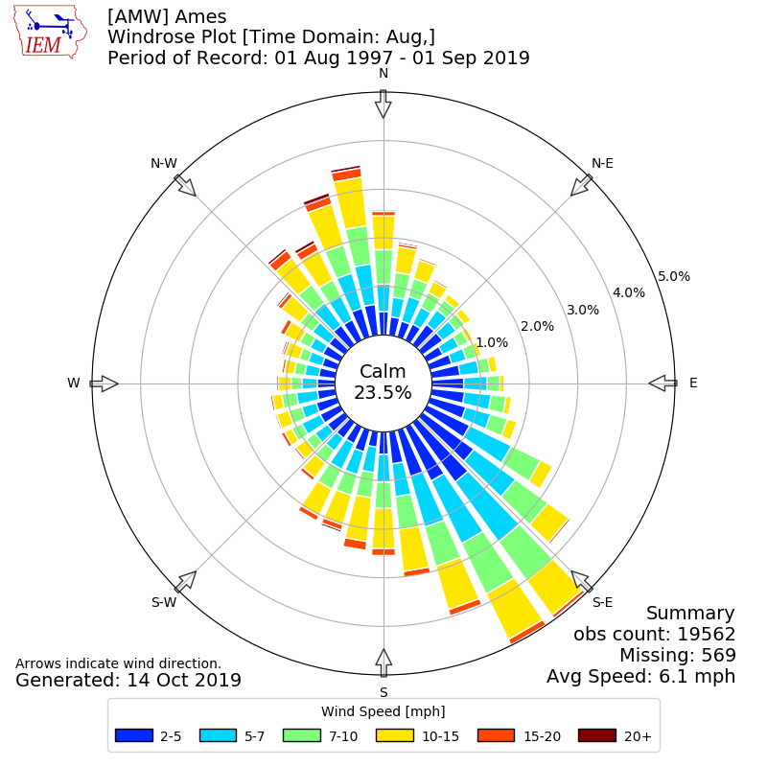
February
August
Web Link

Slide 17
Data Variables to Discuss
Air Temperature, Humidity, and Wind
Precipitation
Soil Moisture/Temperature
Solar Radiation

Slide 18
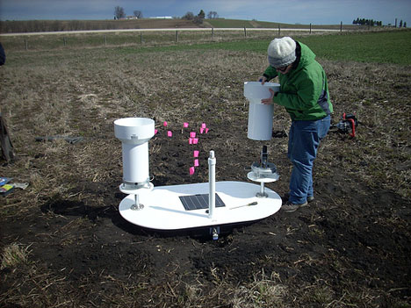
Precipitation Variability
Iowa Flood Center experiment with tipping buckets 3 feet apart
Found some cases of noticeable differences between these two gauges
In general case, which gauge is right? ☺
http://iowafloodcenter.org/notes-from-the-field-rain-gauges/

Slide 19
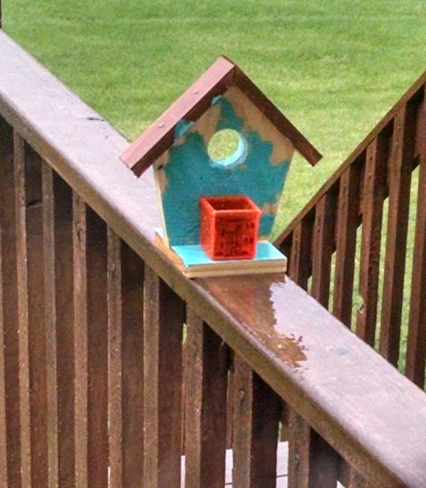
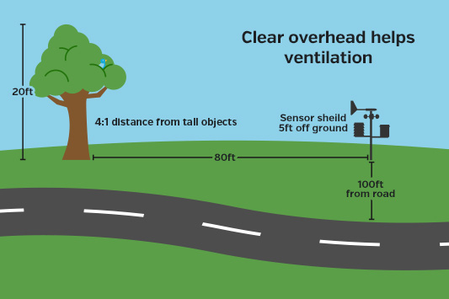
Bah, My weather station at my house is highly accurate!
https://www.wunderground.com/weatherstation/installationguide.asp

Slide 20
The answer to: “How much did it rain in Ames on 25 June 2010?”
IEM QC COOP | 0.00 | SchoolNet | 0.57 | CoCoRaHS | ??? | Stage IV | 0.22
ASOS | 0.13 | RWIS | 0 ? | ISUAG AgFm | 0.25 | NARR | 0.19
ASOS DSM | 1.11 | Lincoln Way | 0 ? | Others | 0.53 | TRMM | 0.51
ASOS DSM Hr | 0.33 | Ada Hayden | 0.93 | DMX 1hr | 0.30
ASOS 1min | 0.36 | H2O Trtment | 0.47 | DMX Storm T | 0.25
We simply average and get: 0.36176470588 inches! What precision!

Slide 21
Data Variables to Discuss
Air Temperature, Humidity, and Wind
Precipitation
Soil Moisture/Temperature
Solar Radiation

Slide 22
ISU Soil Moisture Caveats Galore
Only 12, 24, and 50 inch depth readings for moisture + temperature
4 inch soil temperature is not in the crop field
Sensors don’t work properly when soil is frozen
We’ve had issues with lightning knocking out sensors
Newly installed sensors need time to find equilibrium

Slide 23
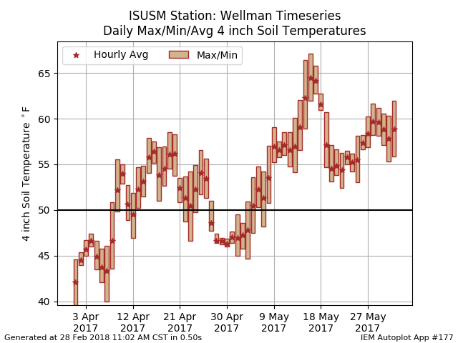
Web Link

Slide 24
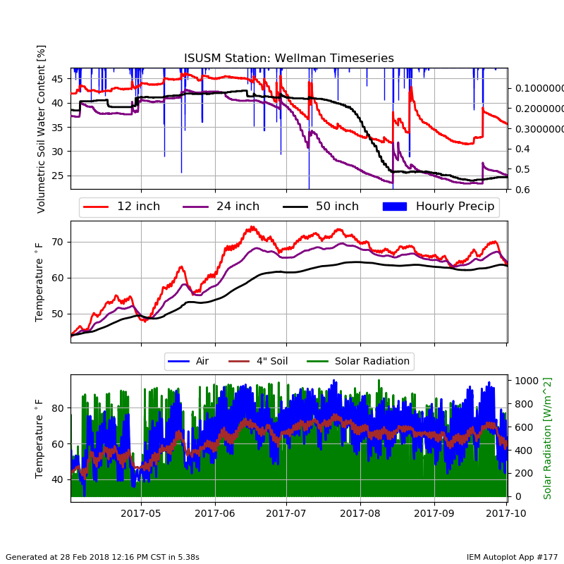
Web Link (Autoplot #177)

Slide 25
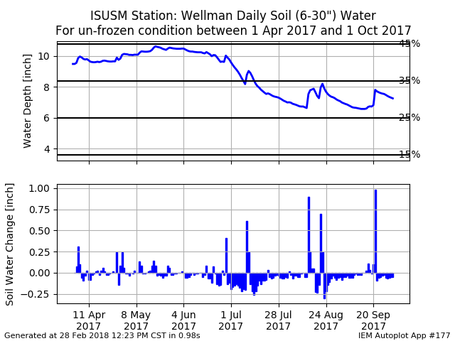
Web Link

Slide 26
Data Variables to Discuss
Air Temperature, Humidity, and Wind
Precipitation
Soil Moisture/Temperature
Solar Radiation

Slide 27
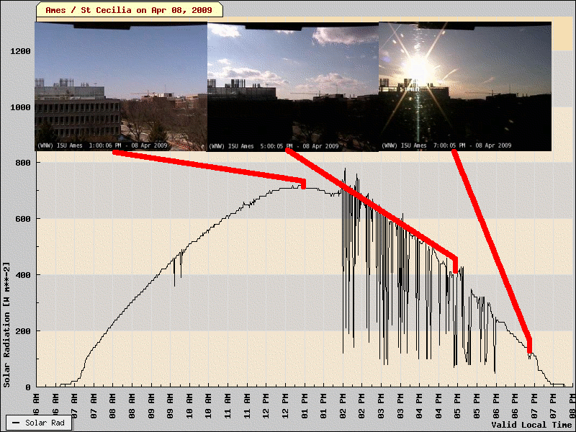
Clear vs Party Cloudy
One minute resolution data shows the impact of individual clouds.
Do you need to know this variability?
Web Link

Slide 28
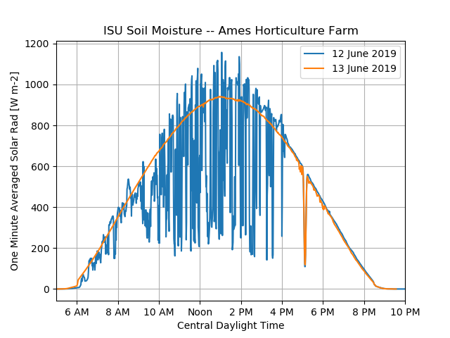
More radiation than during a clear day?
Gold Star for whomever knows what this is?
Web Link

Slide 29
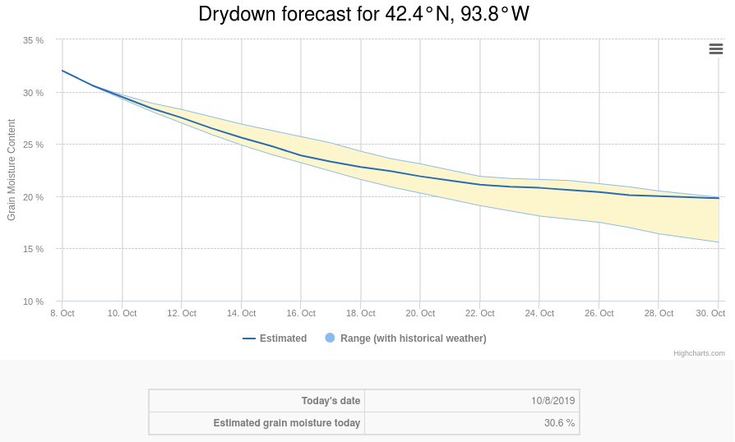
Corn Grain Dry Down Tool

Slide 30
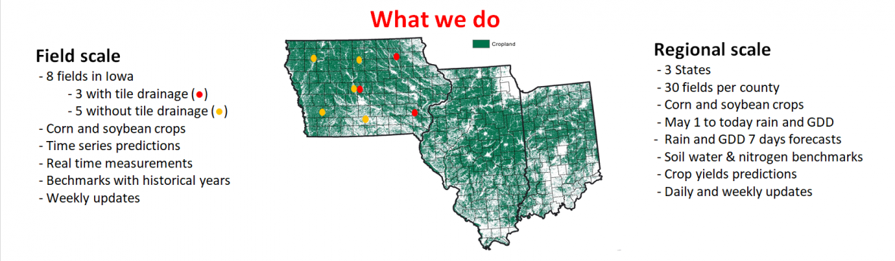

Slide 31
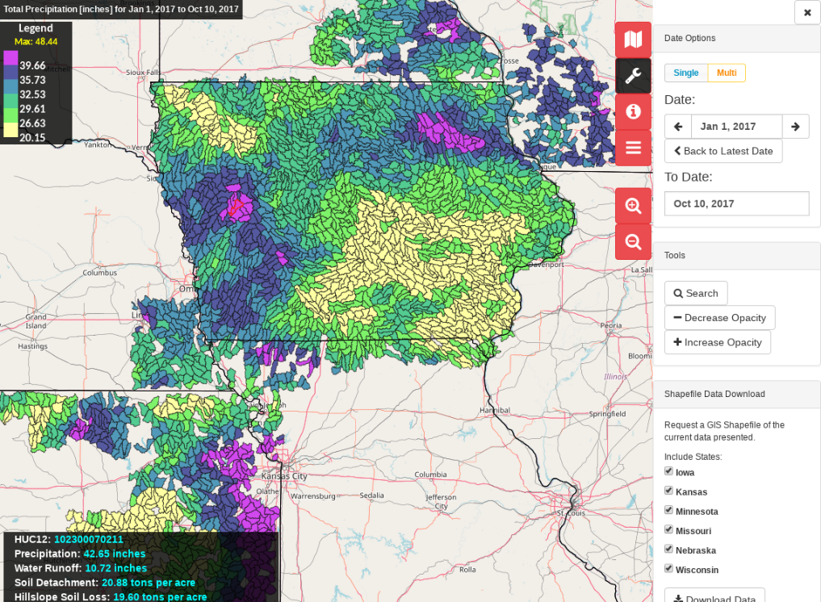

Slide 32

OK, enough of my rambling…. Questions? https://mesonet.agron.iastate.edu “Info” Tab -> Presentations
Twitter: @akrherz
akrherz@iastate.edu
515-451-9249

